Slide 1

ENERLYTICS

Slide 2






ENERLYTICS
(Energy + Analytics)
Why Energy Conservation Matters

Slide 3


Why Saving Energy
is Important
Lowers utility bills
Reduces environmental impact
Slows down climate change
Conserves natural resources

Slide 4


Where Energy
Is Wasted
Leaving lights or appliances on
Poor insulation in homes/buildings
Inefficient appliances
Unnecessary usages

Slide 5




Benefits of
Saving Energy
Financial savings
Longer life for appliances and electronics
Improved air quality
Increased energy security

Slide 6



Introduction
The World Wide Energy Consumption Project focuses on analyzing global data related to energy consumption, production, emissions, GDP, and population. The dataset is sourced from the U.S. Energy Information Administration (EIA) and stored in a structured SQL database.
This project provides an opportunity to explore how economic power, energy usage, and environmental impact are interlinked. By performing SQL-based analysis, we can uncover key insights such as trends in energy demand, the role of population growth in emissions, and how GDP growth correlates with energy production.
The ultimate goal is to understand real-world patterns that highlight the balance (or imbalance) between development and sustainability.

Slide 7
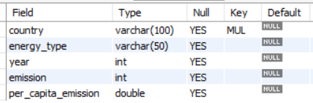

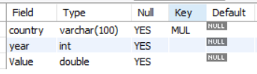
Tables
Emission Table
Country Table
Population Table

Slide 8
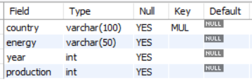
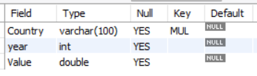
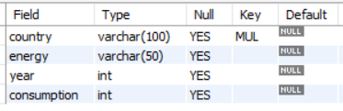
Tables
Production Table
Gdp Table
Consumption Table

Slide 9
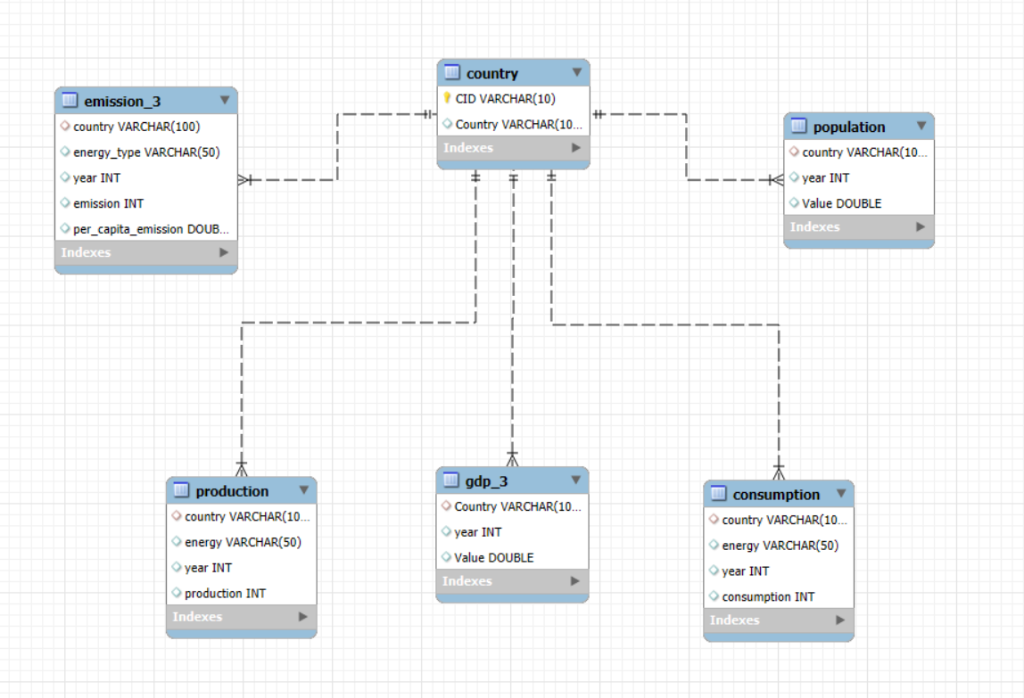
ER Diagram

Slide 10


Problem Statement
Energy consumption and emissions have become critical issues in today’s world, where countries strive for economic growth while tackling climate change. With vast amounts of data available across nations, the challenge is to:
Organize and analyze global datasets of energy, GDP, emissions, and population in a relational database.
Identify trends, ratios, and correlations that explain how energy use influences economic growth and environmental impact.
Compare countries to understand disparities in energy consumption, production, and per-capita emissions.
Provide insights into whether countries are moving towards sustainable energy usage or increasing environmental pressures.
By addressing these challenges, the project aims to deliver data-driven observations that support better understanding of the global energy landscape and its impact on the economy and environment.

Slide 11
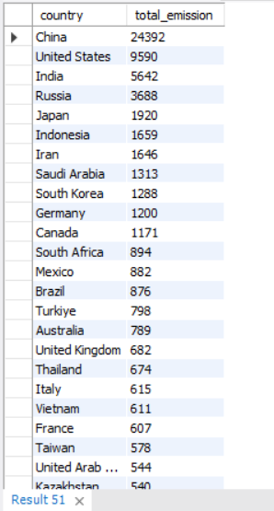
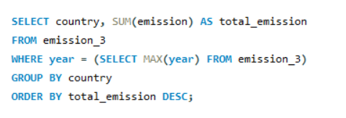

General & Comparative Analysis
What is the total emission per country for the most recent year available?

Slide 12

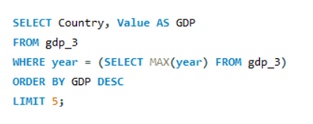
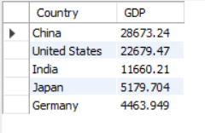
2. What are the top 5 countries by GDP in the most recent year?

Slide 13
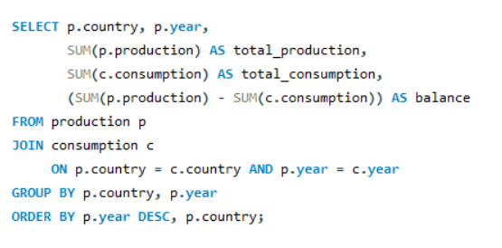
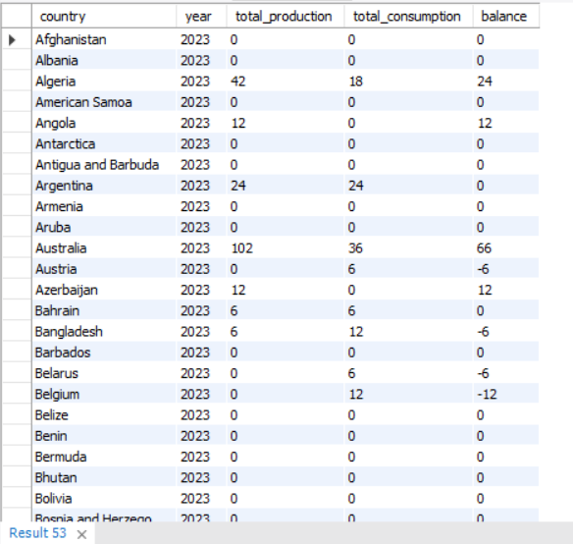

3. Compare energy production and consumption by country and year?

Slide 14

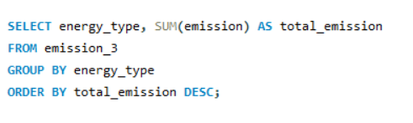
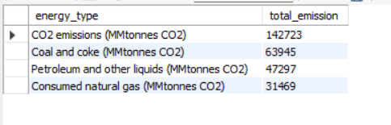
4. Which energy types contribute most to emissions across all countries?

Slide 15
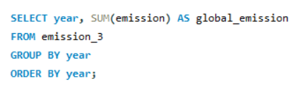

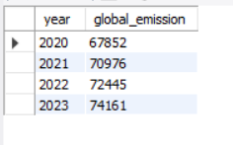
Trend Analysis Over Time
5. How have global emissions changed year over year?

Slide 16
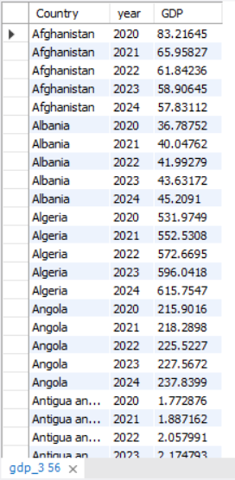
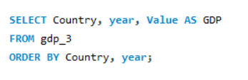

6. What is the trend in GDP for each country over the given years?

Slide 17
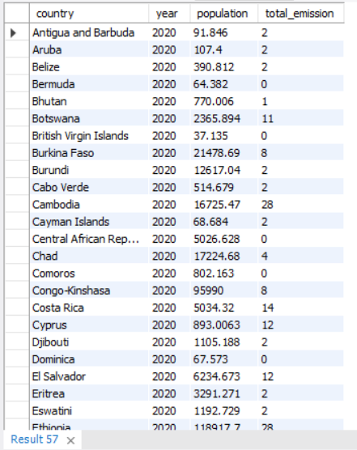
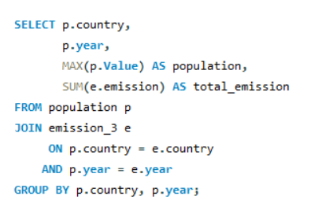

7. How has population growth affected total emissions in each country?

Slide 18
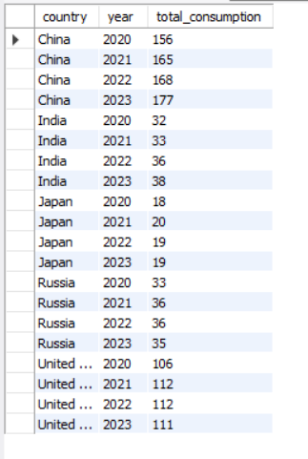
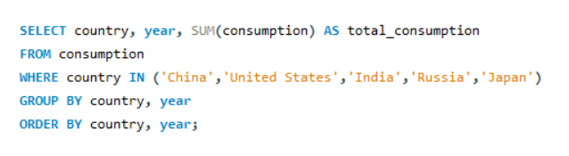

8. Has energy consumption increased or decreased over the years for major economies?

Slide 19
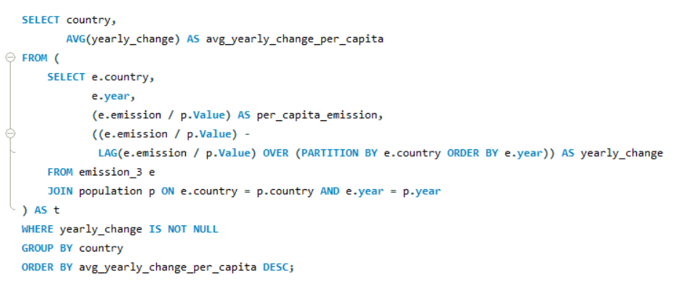
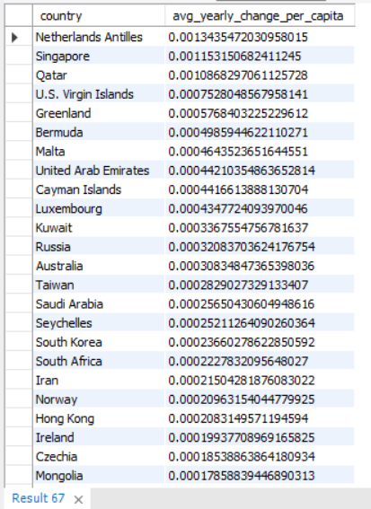

9. What is the average yearly change in emissions per capita for each country?

Slide 20
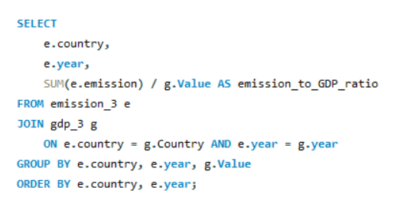
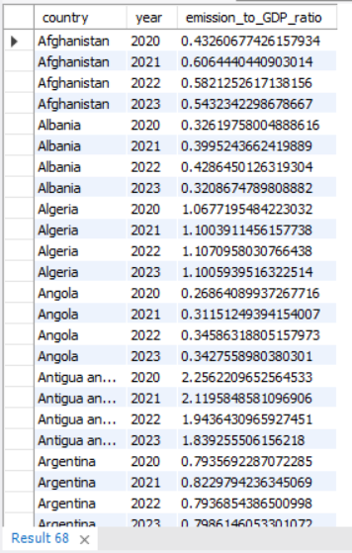

Ratio & Per Capita Analysis
10. What is the emission-to-GDP ratio for each country by year?

Slide 21
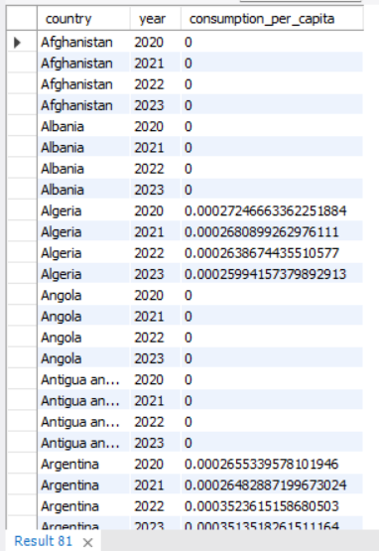
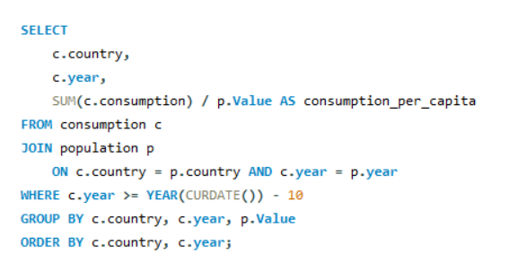

11. What is the energy consumption per capita for each country over the last decade?

Slide 22
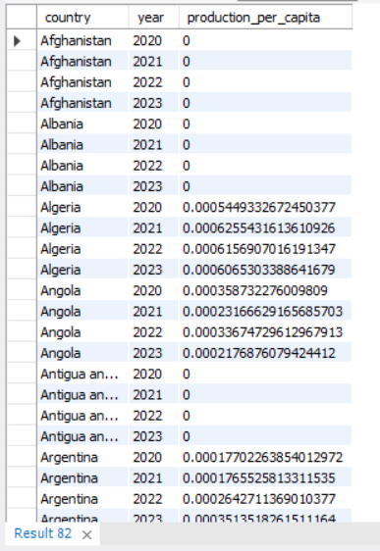
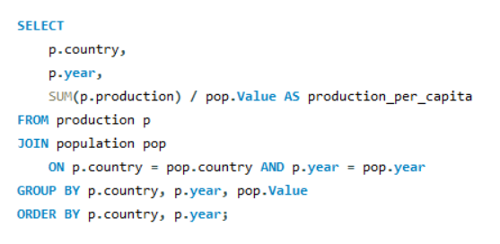

12. How does energy production per capita vary across countries?

Slide 23
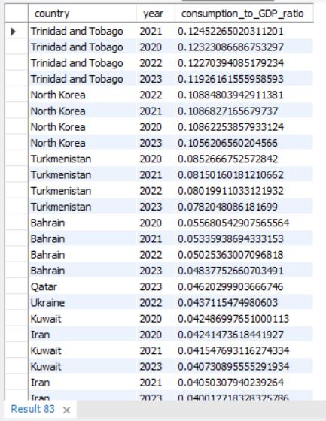
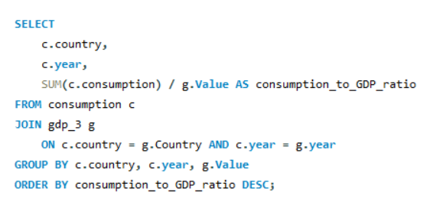

13. Which countries have the highest energy consumption relative to GDP?

Slide 24
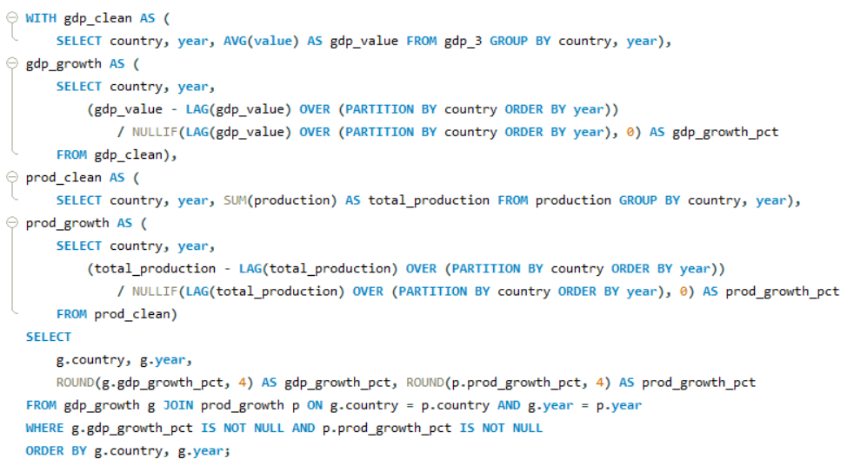
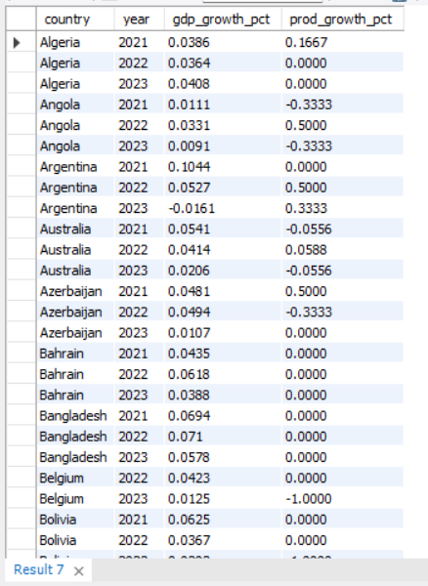

14. What is the correlation between GDP growth and energy production growth?

Slide 25

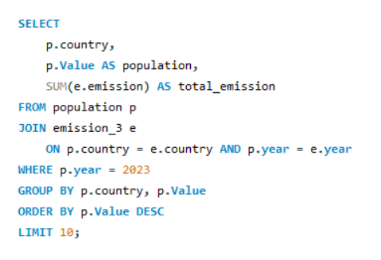
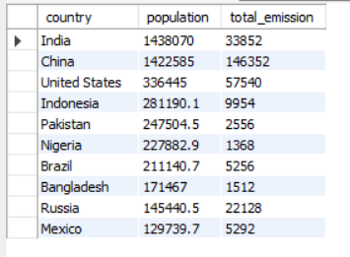
Global Comparisons
15. What are the top 10 countries by population and how do their emissions compare?

Slide 26
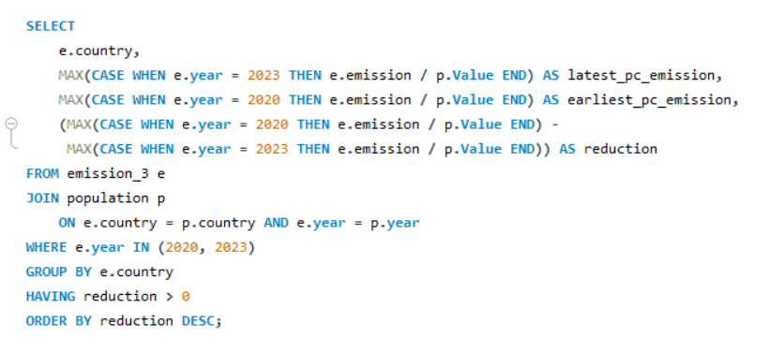
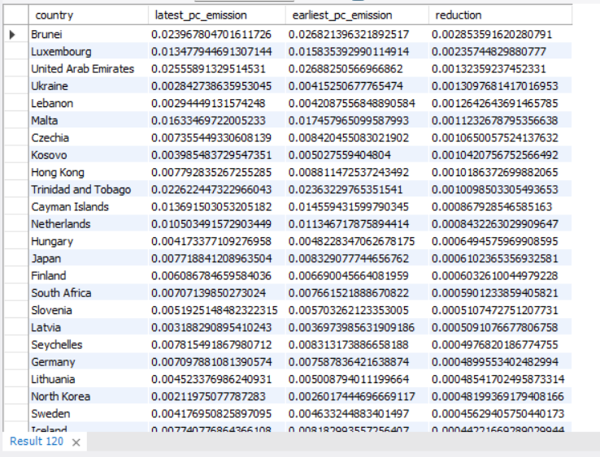
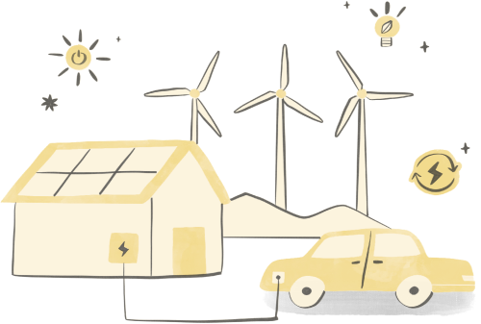
16. Which countries have improved (reduced) their per capita emissions the most over the last decade?

Slide 27
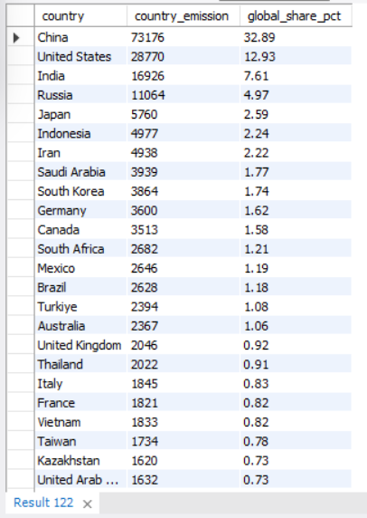
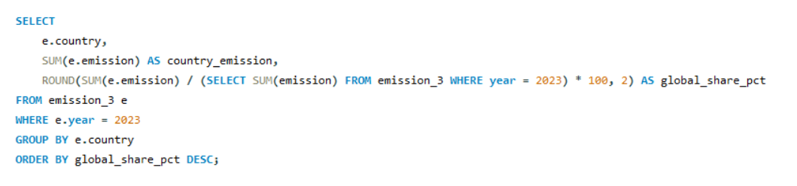

17. What is the global share (%) of emissions by country?

Slide 28

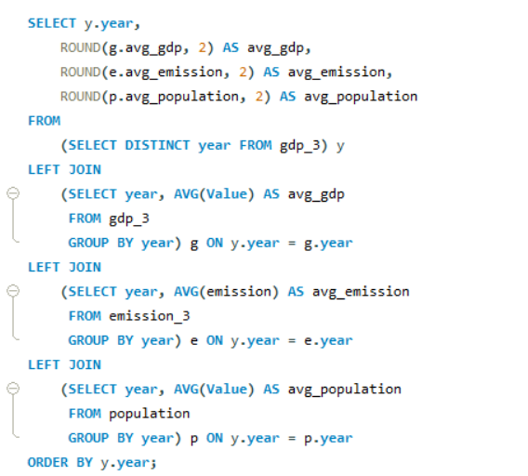
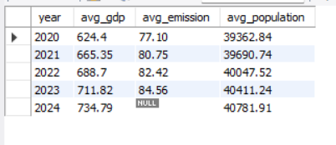
18. What is the global average GDP, emission, and population by year?

Slide 29
INSIGHTS
The top emitting countries in the latest year account for X% of global emissions (use SQL to compute exact %).
Energy types A, B, and C (e.g. coal, oil, gas) are the largest contributors — together accounting for the majority of emissions.
Although GDP grew for many economies, emission-to-GDP ratios decreased for some high-income countries (suggesting decarbonization), while emerging economies often show increasing ratios.
Population growth is positively correlated with total emissions in most countries, but emissions per capita varies widely — indicating efficiency and energy mix differences.
Countries with high production per capita do not always consume more per capita — many are net exporters.
Policy implication: focusing on energy-type decarbonization and improving energy efficiency (lower consumption per GDP) can reduce emissions without sacrificing GDP growth.

Slide 30





Thank
You
Group Members:
Gadhamsetty Harsha
Yeldandi Rohith
Yerrabelli Nithish Rao

